Slide 1


Slide 2
CHAPTER 28
Data Mining Concepts
Slide 28- 2

Slide 3
Chapter Outline
1 Data Mining
  1.1. Data Mining vs. Data Warehousing
  1.2 Knowledge Discovery in Databases (KDD)
  1.3 Goals of Data Mining and Knowledge Discovery
  1.4 Types of Knowledge Discovered
2 Association Rules
  2.1 Association Rules Confidence and Support
  2.2 Apriori Algorithm
  2.3 Sampling Algorithm
  2.4 Frequent Pattern (FP) Tree and Growth Algorithms
  2.5 Partition Algorithm
  2.6 Other types of Association Rules
  2.7 Additional Considerations
Slide 28- <number>

Slide 4
Chapter Outline
3 Classification
4 Clustering
5 Other Data Mining Algorithms
  5.1 Sequential pattern discovery
  5.2 Time Series Analysis
  5.3 Regression
  5.4 Neural Networks
  5.5 Genetic Algorithms
6 Data Mining Applications
7 Commercial Data Mining Tools
Slide 28- <number>

Slide 5
1 Definitions of Data Mining
The discovery of new information in terms of patterns or rules from vast amounts of data.
The process of finding interesting structure in data.
The process of employing one or more computer learning techniques to automatically analyze and extract knowledge from data.
The term data mining is popularly used in a broad sense. In some situations, it includes statistical analysis and constrained optimization as well as machine learning. There is no sharp line separating data mining from these disciplines.
Slide 28- <number>

Slide 6
1.1 Data Mining vs. Data Warehousing
The data warehouse is a historical database designed for decision support.
Data mining can be applied to the data in a warehouse to help with certain types of decisions.
Proper construction of a data warehouse is fundamental to the successful use of data mining.
Most enterprises (Fortune 500 companies) already have data warehouses. They are now trying very hard to benefit from that data with mining techniques.
Slide 28- <number>

Slide 7
1.2 Knowledge Discovery in Databases (KDD)
Data mining is actually one step of a larger process known as Knowledge Discovery in Databases (KDD).
The KDD process model comprises six phases
  Data selection
  Data cleansing
  Enrichment
  Data transformation or encoding
  Data mining
  Reporting and displaying discovered knowledge
Slide 28- <number>

Slide 8
1.3 Goals of Data Mining and Knowledge Discovery (PICO)
Prediction:
  Determine how certain attributes will behave in the future.
Identification:
  Identify the existence of an item, event, or activity.
Classification:
  Partition data into classes or categories.
Optimization:
  Optimize (improve efficiency) of use of limited resources.
Slide 28- <number>

Slide 9
1.3 Goals of Data Mining and Knowledge Discovery (PICO)
Prediction:
Determine how certain attributes will behave in the future.
  Analysis of buying transactions to predict what consumers will buy under certain discounts,
  how much sales volume a store will generate in a given period,
  whether deleting a product line will yield more profits.
  Type of seismic wave patterns that may predict an earthquake with high probability
Slide 28- <number>

Slide 10
1.3 Goals of Data Mining and Knowledge Discovery (PICO)
Identification:
Identify the existence of an item, event, or activity.
  intruders trying to break a system may be identified by the programs executed, files accessed, and CPU time per session.
  In biological applications, existence of a gene may be identified by certain sequences of nucleotide symbols in the DNA sequence.
  In authentication, comparing parameters or images or signals against a database is used to identify users.
Slide 28- <number>

Slide 11
1.3 Goals of Data Mining and Knowledge Discovery (PICO)
Classification:
Partition data into classes or categories.
  customers in a supermarket can be categorized into discount-seeking shoppers, shoppers in a rush, loyal regular shoppers, shoppers attached to name brands, and infrequent shoppers.
Slide 28- <number>

Slide 12
1.3 Goals of Data Mining and Knowledge Discovery (PICO)
Optimization:
Optimize (improve efficiency) of use of limited resources.
  One eventual goal of data mining is to improve efficiency of use of limited resources such as time, space, money, or materials so as to maximize output variables such as sales or profits under a given set of constraints.
Slide 28- <number>

Slide 13
1.4 Types of Discovered Knowledge
Knowledge is broadly interpreted as involving some degree of intelligence.
Knowledge is classified as inductive versus deductive.
Deductive knowledge derives new information based on applying pre-specified logical rules of deduction on the given data.
Inductive knowledge discovers new rules and patterns from supplied data.
Unstructured knowledge may be represented by rules or propositional logic.
Structured knowledge may be represented in decision trees, semantic networks, neural networks, or hierarchies of classes or frames.
Slide 28- <number>

Slide 14
1.4 Types of Discovered Knowledge
Association Rules
Classification Hierarchies
Sequential Patterns
Patterns Within Time Series
Clustering
Slide 28- <number>

Slide 15
2 Association Rules
Association rules correlate the presence of a set of items with another range of values for another set of variables.
Examples:
  When a female retail shopper buys a handbag, she is likely to buy shoes.
  An X-ray image containing characteristics a and b is likely to also exhibit characteristic c.
Slide 28- <number>

Slide 16
2 Association Rules
Association rules are frequently used to generate rules from market-basket data.
  A market basket corresponds to the sets of items a consumer purchases during one visit to a supermarket.
The set of items purchased by customers is known as an itemset.
An association rule is of the form X=>Y, where X ={x₁, x₂, …., x_{n} }, and Y = {y₁,y₂, …., y_{n}} are sets of items, with x_{i} and y_{i} being distinct items for all i and all j.
  For an association rule to be of interest, it must satisfy a minimum support and confidence.
  => implies
Slide 28- <number>

Slide 17
2.1 Association Rules Confidence and Support
Support:
  The support for a rule LHS => RHS is with respect to the itemset; it refers to how frequently a specific itemset occurs in the database.
  It is the minimum percentage of instances in the database that contain all items listed in a given association rule.
  Support is the percentage of transactions that contain all of the items in the itemset, LHS U RHS.
  If the support is low, it implies that there is no overwhelming evidence that items in LHS ∪ RHS occur together because the itemset occurs in only a small fraction of transactions.
  Another term for support is prevalence of the rule.
Confidence:
  Given a rule of the form A=>B, rule confidence is the conditional probability that B is true when A is known to be true.
  It is the probability that the items in RHS will be purchased given that the items in LHS are purchased by a customer.
  Another term for confidence is strength of the rule.
  Confidence can be computed as
    support(LHS U RHS) / support(LHS)
Slide 28- <number>

Slide 18
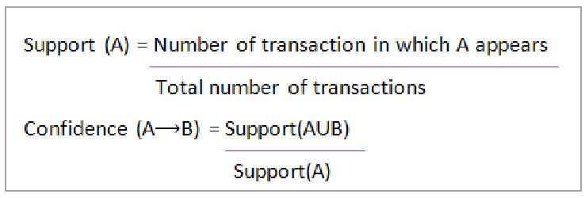
Confidence and Support: Example
Support and Confidence for Itemset A and B are represented by formulas:
Slide 28- <number>

Slide 19
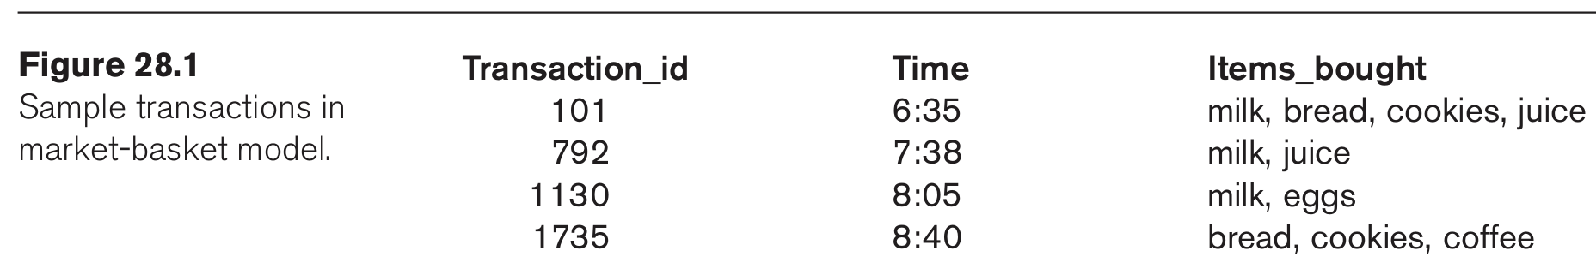
Confidence and Support: Example
Slide 28- <number>

Slide 20
Confidence and Support: Example
From Fig. 28.1, consider the following two rules: milk =>juice and bread => juice.
The support of {milk, juice} is 50% (2 occurrences out of 4) and the support of {bread, juice} is only 25% (1 occurrence out of 4).
The confidence of milk => juice is 66.7% (meaning that, of three transactions in which milk occurs, two contain juice) and the confidence of bread => juice is 50% (meaning that one of two transactions containing bread also contains juice).
Support and confidence do not necessarily go hand in hand.
The goal of mining association rules, is to generate all possible rules that exceed some minimum user-specified support and confidence thresholds.
Slide 28- <number>

Slide 21
2.2 Generating Association Rules and Apriori Algorithm
The general algorithm for generating association rules is a two-step process.
  Generate all itemsets that have a support exceeding the given threshold. Itemsets with this property are called large or frequent itemsets.
  Generate rules for each itemset as follows:
    For itemset X and Y a subset of X, let Z = X – Y;
    If support(X)/Support(Z) > minimum confidence, the rule Z=>Y is a valid rule.
Slide 28- <number>

Slide 22
Reducing Association Rule Complexity
Two properties are used to reduce the search space for association rule generation.
  Downward Closure
    A subset of a large itemset must also be large
  Anti-monotonicity
    A superset of a small itemset is also small. This implies that the itemset does not have sufficient support to be considered for rule generation.
Slide 28- <number>

Slide 23
The Apriori Algorithm (1)
The Apriori algorithm was the first algorithm used to generate association rules.
  The Apriori algorithm uses the general algorithm for creating association rules together with downward closure and anti-monotonicity.
Slide 28- <number>

Slide 24
The Apriori Algorithm (2)
Algorithm 28.1. Apriori Algorithm for Finding Frequent (Large) Itemsets
Input: Database of m transactions, D, and a minimum support, mins, represented as a fraction of m.
Output: Frequent itemsets, L₁, L₂, ..., L_{k}
Begin /* steps or statements are numbered for better readability */
1. Compute support(i_{j}) = count(i_{j})/m for each individual item, i₁, i₂, ..., i_{n} by scanning the database once and counting the number of transactions that item i_{j} appears in (that is, count(i_{j}));
Slide 28- <number>

Slide 25
The Apriori Algorithm (3)
2. The candidate frequent 1-itemset, C₁, will be the set of items i₁, i₂, ..., i_{n};
3. The subset of items containing i_{j} from C₁ where support(i_{j}) >= mins becomes the frequent 1-itemset, L₁;
4. k = 1;
termination = false;
repeat
…..
until termination (for this part see the next slide)
Slide 28- <number>

Slide 26
The Apriori Algorithm (4)
repeat
1. L_{k+1} = (empty set) ;
2. Create the candidate frequent (k+1)-itemset, C_{k+1}, by combining members of L_{k} that have k–1 items in common (this forms candidate frequent (k+1)-itemsets by selectively extending frequent k-itemsets by one item);
3. In addition, only consider as elements of C_{k+1} those k+1 items such that every subset of size k appears in L_{k};
4. Scan the database once and compute the support for each member of C_{k+1}; if the support for a member of C_{k+1} >= mins then add that member to L_{k+1};
5. If L_{k+1} is empty then termination = true
else k = k + 1;
until termination;
End;
Slide 28- <number>

Slide 27
2.3 The Sampling Algorithm
The sampling algorithm selects samples from the database of transactions that individually fit into memory. Frequent itemsets are then formed for each sample.
  If the frequent itemsets form a superset of the frequent itemsets for the entire database, then the real frequent itemsets can be obtained by scanning the remainder of the database.
The negative border with respect to a frequent itemset, S, and set of items, I, is the minimal itemsets contained in PowerSet(I) and not in S.
Slide 28- <number>

Slide 28
2.3 The Sampling Algorithm (2)
The negative border of a set of frequent itemsets contains the closest itemsets that could also be frequent.
Consider the case where a set X is not contained in the frequent itemsets. If all subsets of X are contained in the set of frequent itemsets, then X would be in the negative border.
If X in the negative border is in the frequent itemsets then there is potential for a superset of X to be in frequent itemsets. In such cases a second pass over the database is needed to make sure all frequent datasets are found.
Slide 28- <number>

Slide 29
2.4 Frequent-Pattern Tree Algorithm
The Frequent-Pattern Tree Algorithm reduces the total number of candidate itemsets by producing a compressed version of the database in terms of an FP-tree.
The FP-tree stores relevant information and allows for the efficient discovery of frequent itemsets.
The algorithm consists of two steps:
  Step 1 builds the FP-tree.
  Step 2 uses the tree to find frequent itemsets.
Slide 28- <number>

Slide 30
Step 1: Building the FP-Tree
First, frequent 1-itemsets along with the count of transactions containing each item are computed.
The 1-itemsets are sorted in non-increasing order.
The root of the FP-tree is created with a “null” label.
For each transaction T in the database, place the frequent 1-itemsets in T in sorted order. Designate T as consisting of a head and the remaining items, the tail.
Insert itemset information recursively into the FP-tree as follows:
  if the current node, N, of the FP-tree has a child with an item name = head, increment the count associated with N by 1 else create a new node, N, with a count of 1, link N to its parent and link N with the item header table.
  if tail is nonempty, repeat the above step using only the tail, i.e., the old head is removed and the new head is the first item from the tail and the remaining items become the new tail.
Slide 28- <number>

Slide 31
Step 2: The FP-growth Algorithm For Finding Frequent Itemsets
Algorithm 28.2 FP-Growth Algorithm Input: Fp-tree and minimum support, mins
Output: frequent patterns (itemsets)
procedure FP-growth (tree, alpha);
Begin
if tree contains a single path P then
for each combination, beta of the nodes in the path
generate pattern (beta ∪ alpha)
with support = minimum support of nodes in beta
else
for each item, i, in the header of the tree do
begin
generate pattern beta = (i ∪ alpha) with support = i.support;
construct beta’s conditional pattern base;
construct beta’s conditional FP-tree, beta_tree;
if beta_tree is not empty then
FP-growth(beta_tree, beta);
end;
End;
Slide 28- <number>

Slide 32
2.5 The Partition Algorithm
Divide the database into non-overlapping subsets.
Treat each subset as a separate database where each subset fits entirely into main memory.
Apply the Apriori algorithm to each partition.
Take the union of all frequent itemsets from each partition.
These itemsets form the global candidate frequent itemsets for the entire database.
Verify the global set of itemsets by having their actual support measured for the entire database.
Slide 28- <number>

Slide 33
Association Rules among hierarchies (1)
Certain types of associations occur among hierarchies of items.
For example, foods in a supermarket, items in a department store, or articles in a sports shop can be categorized into classes and subclasses that give rise to hierarchies.
Figure 28.3 shows the taxonomy of items in a supermarket, with two hierarchies—beverages and desserts.
Slide 28- <number>

Slide 34
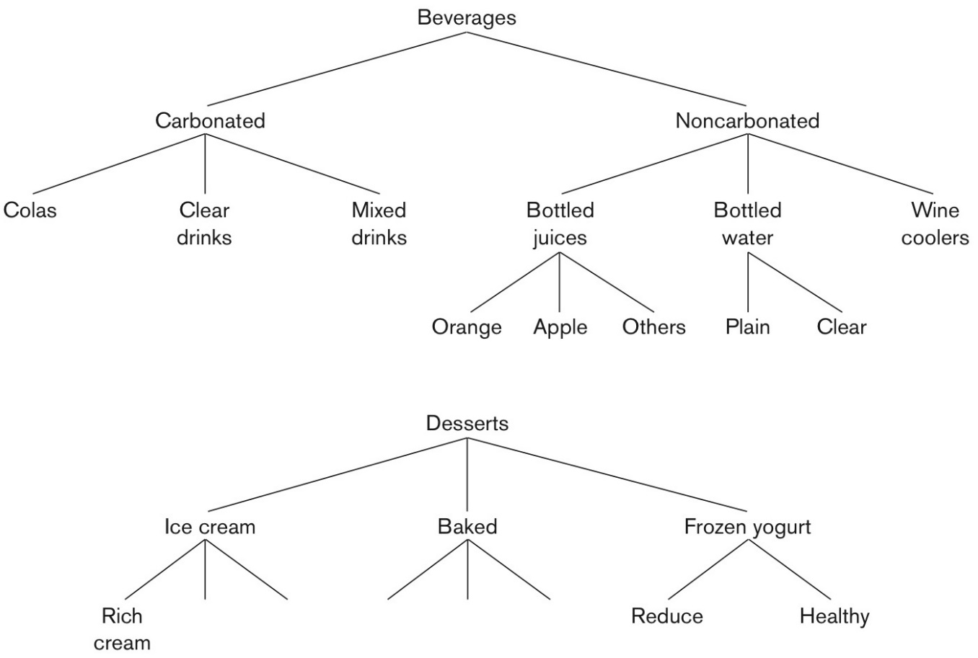
Association Rules among hierarchies (2)
Figure 28.3 Taxonomy of items in a supermarket.
Slide 28- <number>

Slide 35
Association Rules among hierarchies (3)
The entire groups may not produce associations of the form
  beverages => desserts, or desserts => beverages.
However, associations of the type
  Healthy-brand frozen yogurt => bottled water, or Rich cream-brand ice cream => wine cooler
may produce enough confidence and support to be valid association rules.
Slide 28- <number>

Slide 36
Multi-dimensional Association Rules
The following rule is an example of including the label of the single dimension:
  Items_bought(milk) => Items_bought(juice).
It may be of interest to find association rules that involve multiple dimensions, for example,
  Time(6:30...8:00) => Items_bought(milk).
Rules like these are called multidimensional association rules. The dimensions represent attributes of records of a file or, in terms of relations, columns of rows of a relation, and can be categorical or quantitative
Slide 28- <number>

Slide 37
Multi-dimensional and Negative Association Rules
One approach to handling a quantitative attribute is to partition its values into non-overlapping intervals.
E.g., consider the salary attribute:
  (0 < Salary < 29,999 ) = > {Kia, Hyundai}
  (30,000 < salary < 99,999) => {Honda, Toyota}
  (100,000 < salary < 149,000) => {Lexus, Mercedes}
  (150,000 < salary < 300,000) => {Porsche, BMW}
Negative Association Rules: E.g.. those who buy
Soft_drink “Wakeup” are not likely to buy chips “Nightos”. It is very difficult to discover these because support is very low by definition. See the discussion in the text and
Savasere, Omiecinski and Navathe, “Mining Strong Negative Association in a Large Database of Customer Transactions,” Int. Conf. on Data Mining, 1998.
Slide 28- <number>

Slide 38
Complications seen with Association Rules
The cardinality of itemsets in most situations is extremely large.
Association rule mining is more difficult when transactions show variability in factors such as geographic location and seasons.
Item classifications exist along multiple dimensions. Those must be taken into account.
Data quality is variable; data may be missing, erroneous, conflicting, as well as redundant.
Slide 28- <number>

Slide 39
3. Classification
Classification is the process of learning a model that is able to describe different classes of data.
Learning is supervised as the classes to be learned are predetermined.
Learning is accomplished by using a training set of pre-classified data.
The model produced is usually in the form of a decision tree or a set of rules.
Slide 28- <number>

Slide 40
Decision Tree Construction (1)
Algorithm 28.3. Algorithm for Decision Tree Induction
Input: Set of training data records: R₁, R₂, ..., R_{m} and set of attributes: A₁, A₂, ..., A_{n}
Output: Decision tree
procedure Build_tree (records, attributes);
Begin
create a node N;
if all records belong to the same class, C then
return N as a leaf node with class label C;
if attributes is empty then return N as a leaf node with class label C, such that the majority of records belong to it;
select attribute A_{i} (with the highest information gain) from attributes;
label node N with A_{i};
Slide 28- <number>

Slide 41
Decision Tree Construction (2)
for each known value, v_{j}, of A_{i} do
begin
add a branch from node N for the condition A_{i} = v_{j};
S_{j} = subset of records where A_{i} = v_{j};
if S_{j} is empty then
add a leaf, L, with class label C, such that the majority
of records belong to it and return L
else add the node returned by Build_tree(S_{j},
attributes – A_{i});
end;
End;
Slide 28- <number>

Slide 42
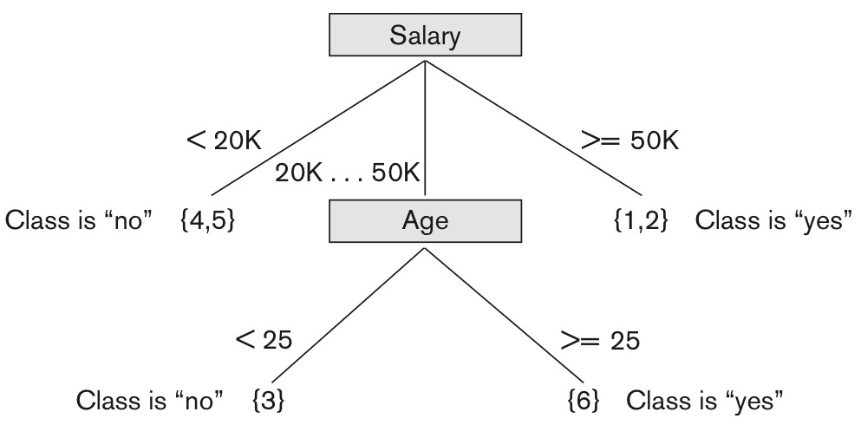
Figure 28.7 Decision tree based on sample training data
Figure 28.7 Decision tree based on sample training data where the leaf nodes are represented by a set of RIDs of the partitioned records.
Slide 28- <number>

Slide 43
An Example Rule
Here is one of the rules extracted from the decision tree of Figure 28.7.
  IF 50K > salary >= 20K
  AND age >=25
  THEN class is “yes”
Another rule
  IF 50K > salary >= 20K
  AND age < 25
  THEN class is “no”
Slide 28- <number>

Slide 44
4 Clustering
Unsupervised learning or clustering builds models from data without predefined classes.
The goal is to place records into groups where the records in a group are highly similar to each other and dissimilar to records in other groups.
The k-Means algorithm is a simple yet effective clustering technique.
Slide 28- <number>

Slide 45
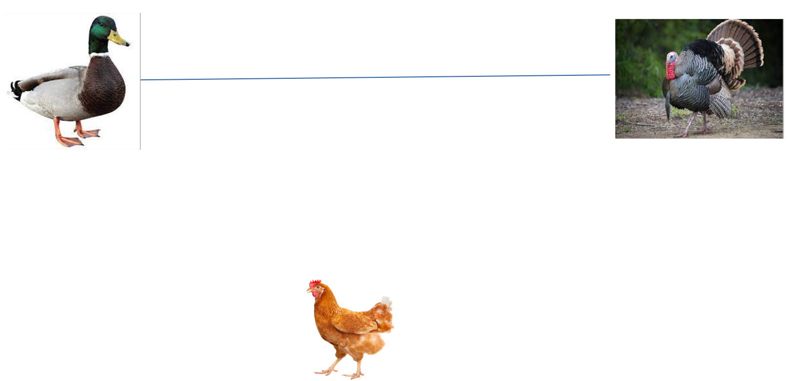
Duck and Turkey vs Chicken

Slide 46
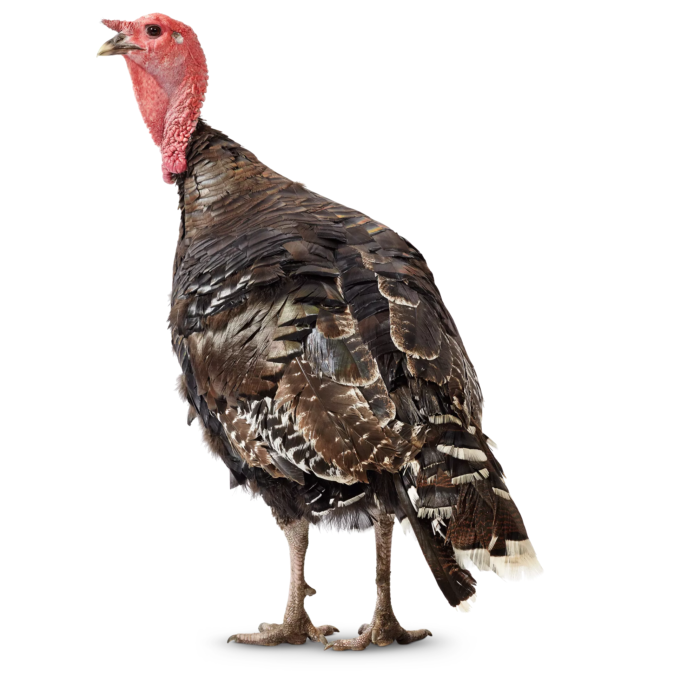
Duck and Turkey vs Chicken

Slide 47
K-Means Clustering
Algorithm 28.4. k-Means Clustering Algorithm
Input: a database D, of m records, r₁, ..., r_{m} and a desired number of clusters k
Output: set of k clusters that minimizes the squared error criterion
Begin
randomly choose k records as the centroids for the k clusters;
repeat
assign each record, r_{i}, to a cluster such that the distance between r_{i}
and the cluster centroid (mean) is the smallest among the k
clusters;
recalculate the centroid (mean) for each cluster based on the records
assigned to the cluster;
until no change;
End;
Slide 28- <number>

Slide 48
5 Additional Approaches for Data Mining
Sequential pattern analysis
  Looks for a sequence of itemsets
  Transactions ordered by time of purchase form a sequence of itemsets.
  The support for a sequence S of itemsets is the percentage of the given set U of sequences of which S is a subsequence
  Assuming we are analyzing sequences of items as a time series for a customer, The sequence S₁, S₂, S₃, ... is a predictor of the fact that a customer who buys itemset S₁ is likely to buy itemset S₂ and then S₃, and so on.
Slide 28- <number>

Slide 49
5.2 Time Series Analysis
Time Series analysis
  Time series are sequences of events; each event may be a given fixed type of a transaction.
    For example, the closing price of a stock or a fund is an event that occurs every weekday for each stock and fund. The sequence of these values per stock or fund constitutes a time series.
    For a time series, one may look for a variety of patterns by analyzing sequences and sub-sequences as we did above.
    Time series may be compared by establishing measures of similarity to identify companies whose stocks behave in a similar fashion
Time series analysis is an extended functionality of temporal data management.
Slide 28- <number>

Slide 50
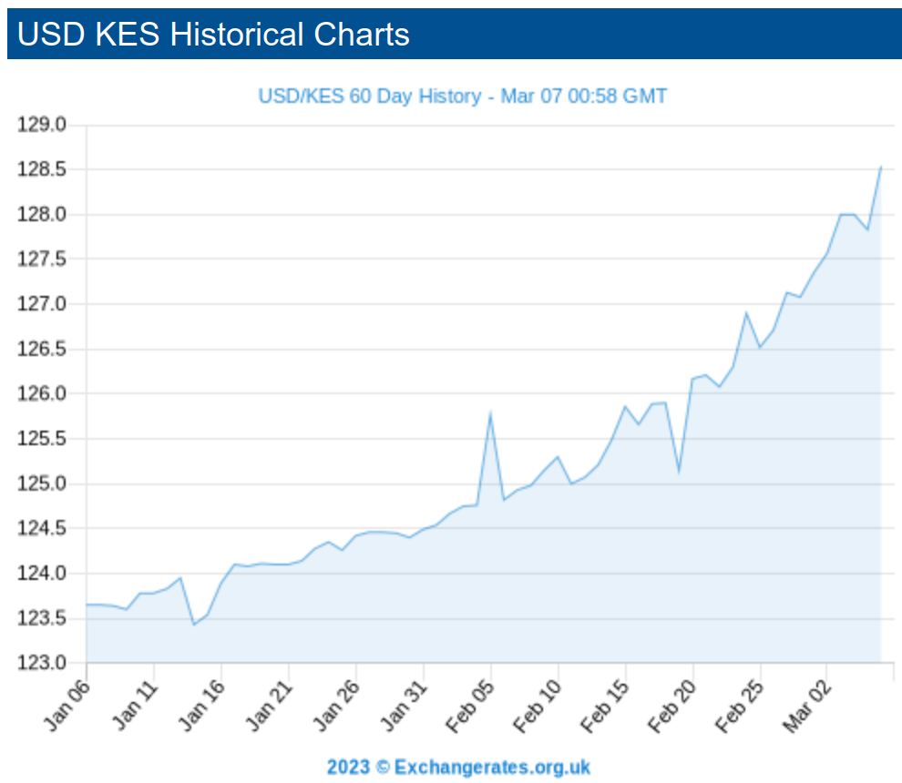
Market time series

Slide 51
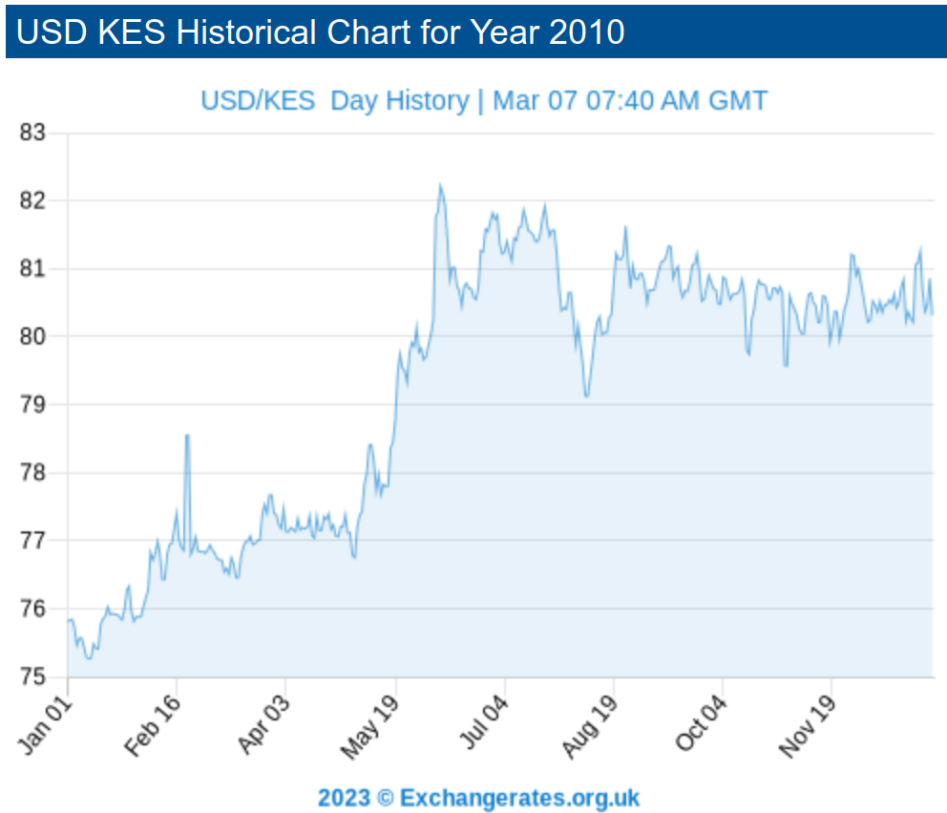
Market time series

Slide 52
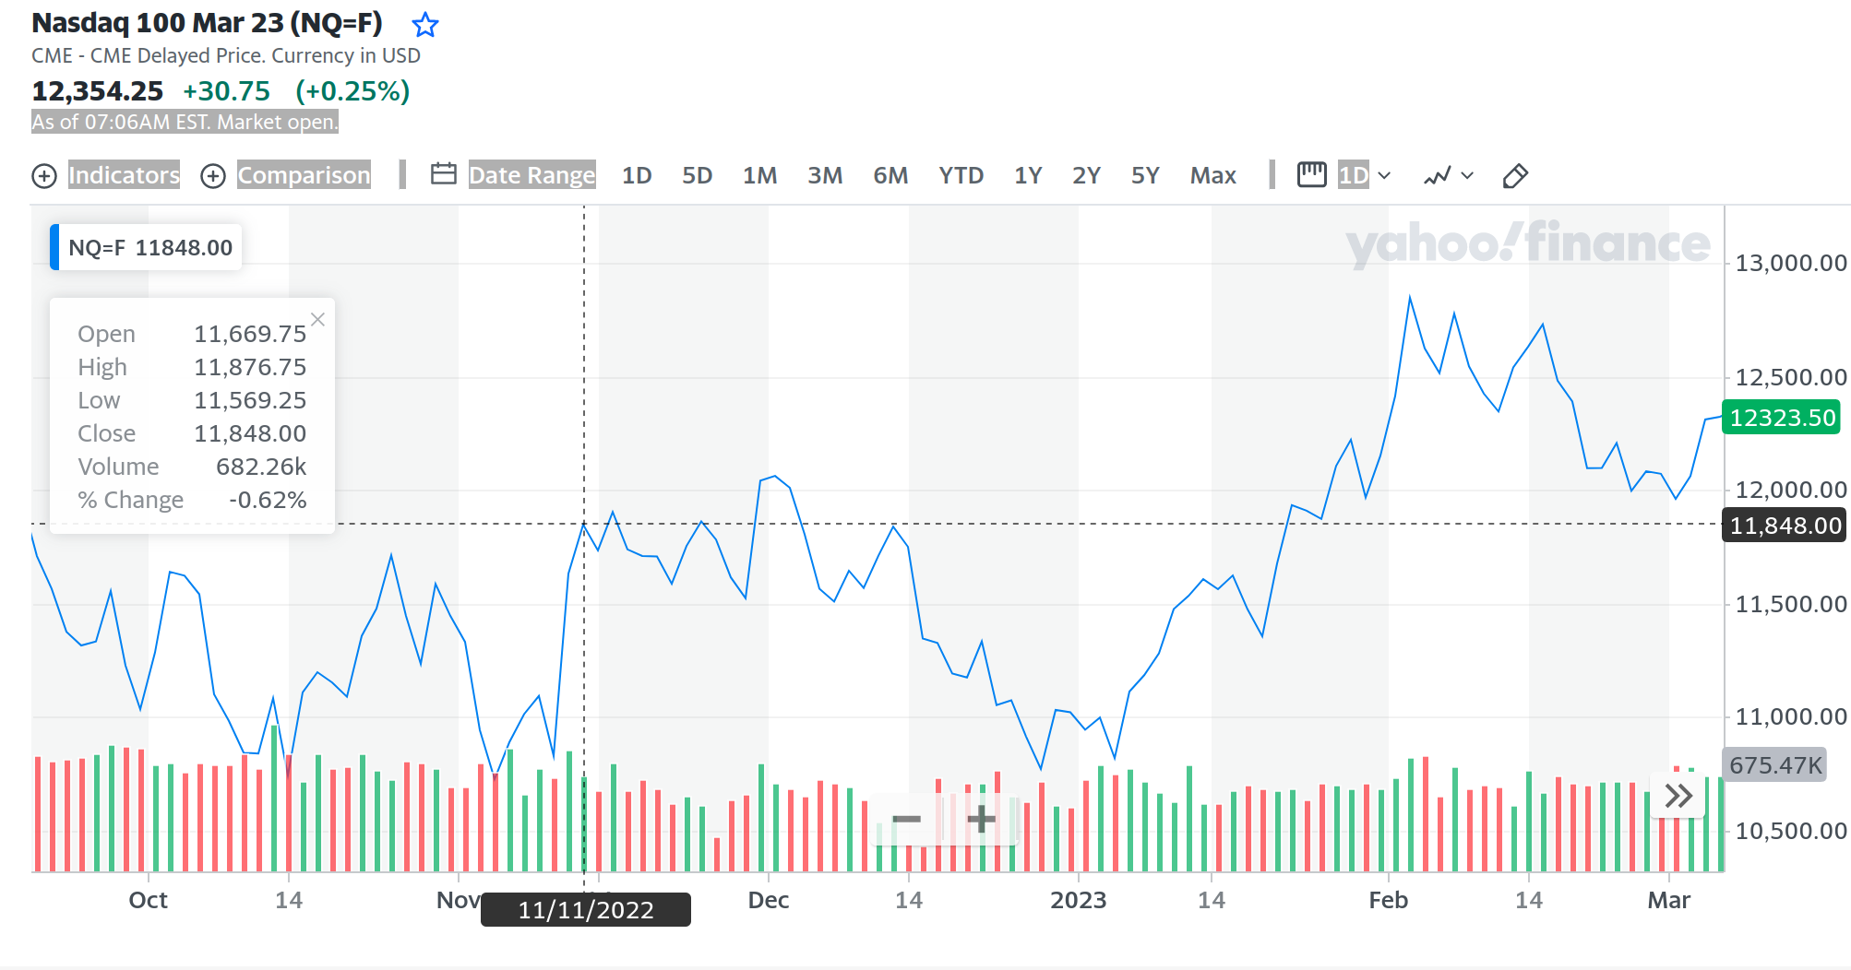
Market time series

Slide 53
5.3 Regression (1)
Regression
Regression is a special application of the classification rule.
If a classification rule is regarded as a function over the variables that maps these variables into a target class variable, the rule is called a regression rule.
A regression equation (or function) estimates a dependent variable using a set of independent variables and a set of constants.
  For example, consider a relation
LAB_TESTS (patient ID, test 1, test 2, ..., test n)
which contains values that are results from a series of n tests for one
patient.
The target variable that we wish to predict is P, the probability of survival of the patient. Then the rule for regression takes the form:
Slide 28- <number>

Slide 54
Regression (2)
Regression
(test 1 in range₁) and (test 2 in range₂) and ... (test n in range_{n}) ⇒ P = x, or x < P <= y
In the above example, we regard P as a function:
P = f (test 1, test 2, ..., test n)
If the function appears as
Y = f (X₁, X₂, ..., X_{n}),
and f is linear in the domain variables x_{i}, the process of
deriving f from a given set of tuples for <X₁, X₂, ..., X_{n}, y> is
called linear regression.
Linear regression is a commonly used statistical technique for fitting a set of observations or points in n dimensions with the target variable y.
Slide 28- <number>

Slide 55
5.4 Neural Networks
The inventor of the first neurocomputer, Dr. Robert Hecht-Nielsen, defines a neural network as −
    "...a computing system made up of a number of simple, highly interconnected processing elements, which process information by their dynamic state response to external inputs.”
The idea of ANNs is based on the belief that working of human brain by making the right connections, can be imitated using silicon and wires as living neurons and dendrites.
The human brain is composed of 86 billion nerve cells called neurons. They are connected to other thousand cells by Axons. Stimuli from external environment or inputs from sensory organs are accepted by dendrites.
These inputs create electric impulses, which quickly travel through the neural network.
Slide 28- <number>

Slide 56
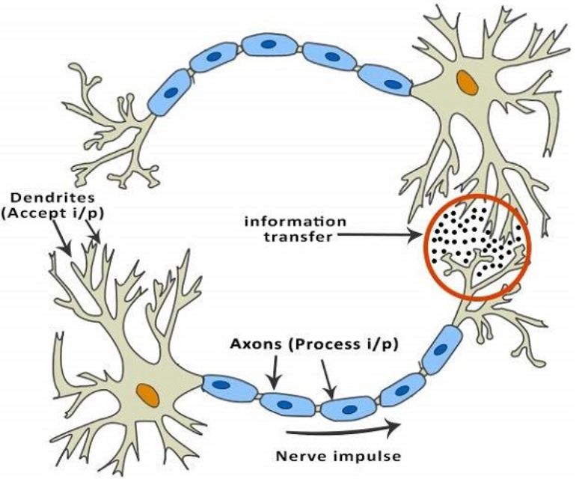
5.4 Neural Networks
These inputs create electric impulses, which quickly travel through the neural network.
A neuron can then send the message to other neuron to handle the issue or does not send it forward.
Slide 28- <number>

Slide 57
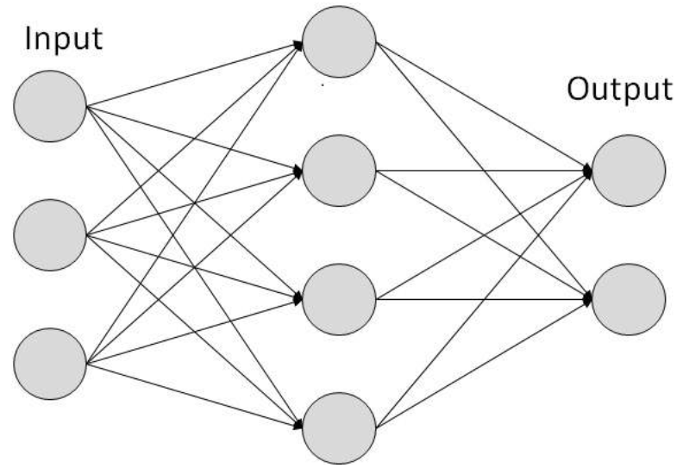
5.4 Neural Networks
ANNs are composed of multiple nodes, which imitate biological neurons of human brain.
The neurons are connected by links and they interact with each other.
The nodes can take input data and perform simple operations on the data.
The result of these operations is passed to other neurons. The output at each node is called its activation or node value.
Slide 28- <number>

Slide 58
5.4 Neural Networks
A Neural Network is a set of interconnected nodes designed to imitate the functioning of the brain.
Node connections have weights which are modified during the learning process.
Neural networks are of two types: supervised and unsupervised.
Adaptive methods that attempt to reduce the output error are supervised learning methods
Those that develop internal representations without sample outputs are called unsupervised learning methods.
The output of a supervised neural network is quantitative and not easily understood.
Unsupervised networks learn; but they do not provide a good representation of what they learn
Although neural networks suffer from above shortcomings and cannot easily deal with time series data, they are still popular.
Slide 28- <number>

Slide 59
5.5 Genetic Algorithms (1)
Genetic algorithms (GAs) are a class of randomized search procedures capable of adaptive and robust search over a wide range of search space topologies.
Modeled after the adaptive emergence of biological species from evolutionary mechanisms, Genetic learning is based on the theory of evolution.
An initial population of several candidate solutions is provided to the learning model.
A fitness function defines which solutions survive from one generation to the next.
Crossover, mutation and selection are used to create new population elements.
Slide 28- <number>

Slide 60
Genetic Algorithms (2)
The solutions produced by GAs are distinguished from most other search techniques by the following characteristics:
  A GA search uses a set of solutions during each generation rather than a single solution.
  The search in the string-space represents a much larger parallel search in the space of encoded solutions.
  The memory of the search done is represented solely by the set of solutions available for a generation.
  A genetic algorithm is a randomized algorithm since search mechanisms use probabilistic operators.
  While progressing from one generation to the next, a GA finds near-optimal balance between knowledge acquisition and exploitation by manipulating encoded solutions.
Slide 28- <number>

Slide 61
6 Data Mining / Business Analytics (B.I.) Applications
Marketing
  Marketing strategies and consumer behavior. Advertising, Service location, Customer Segmentation, Targeted mailing
Finance
  Fraud detection, creditworthiness and investment performance analysis
Manufacturing
  Resource optimization of men, machines and materials
Health
  Image analysis, genetic analysis, side effects of drug, and treatment effectiveness, process and cost optimization in healthcare services
Slide 28- <number>

Slide 62
7 Data Mining Tools
Currently, commercial data mining tools use several common techniques to extract knowledge. These include association rules, clustering, neural networks, sequencing, and statistical analysis.
Also used are decision trees, which are a representation of the rules used in classification or clustering, and statistical analyses, which may include different types of regression and many other techniques.
Some commercial products use advanced techniques such as genetic algorithms, case-based reasoning, Bayesian networks, nonlinear regression, combinatorial optimization, pattern matching, and fuzzy logic.
A set of representative tools are presented in Table 28.2
Slide 28- <number>

Slide 63
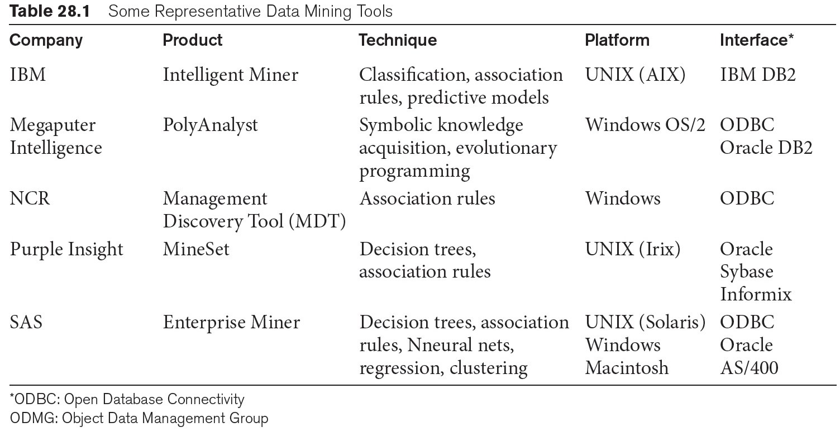
Some Commercial Data Mining Tools
Other commercial products use advanced techniques such as genetic algorithms, case-based reasoning, Bayesian networks, nonlinear regression, combinatorial optimization, pattern matching, and fuzzy logic.
Slide 28- <number>

Slide 64
Future of Data Mining
Data mining tools are continually evolving, building on ideas from the latest scientific research.
  Many of these tools incorporate the latest algorithms taken from artificial intelligence (AI), machine learning (which is a very parallel term), statistics, and optimization.
The primary direction for data mining is to analyze terabytes and petabytes of data in the so-called Big Data systems which we presented in Chapter 25.
Big Data systems are being equipped with their own tools and libraries for data mining such as Mahout which runs on top of Hadoop.
The data mining area will also be closely tied to data that will be housed in the cloud in data warehouses and brought into service for mining operations as needed using OLAP (Online Analytical Processing) servers.
Business Analytics is the primary goal of the currently advancing Spark technology.
Slide 28- <number>

Slide 65
Recap
Data Mining
Data Warehousing
Knowledge Discovery in Databases (KDD)
Goals of Data Mining and Knowledge Discovery
Association Rules
Classification
Clusering
Additional Data Mining Algorithms
  Sequential pattern analysis
  Time Series Analysis
  Regression
  Neural Networks
  Genetic Algorithms
Data Mining Applications
Commercial Data Mining Tools and Future Directions.
Slide 28- <number>

